Slide 1
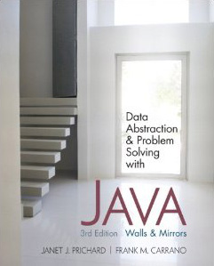
Chapter 9 (continued)
Advanced Java Topics
© 2011 Pearson Addison-Wesley. All rights reserved
9 B-<number>

Slide 2
Abstract Classes
Example
  CD player and DVD player
    Both involve an optical disk
    Operations
      Insert, remove, play, record, and stop such discs
© 2011 Pearson Addison-Wesley. All rights reserved
9 B-<number>

Slide 3
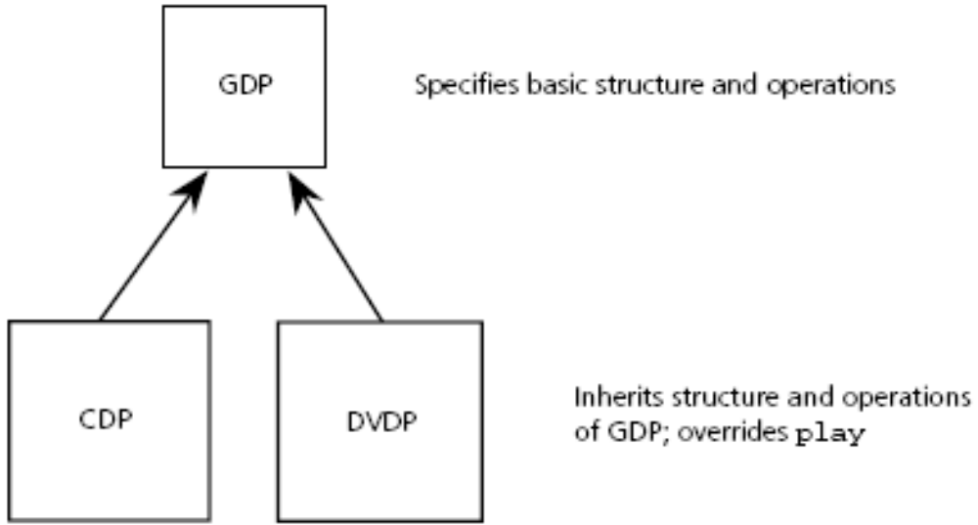
Abstract Classes
Figure 9-8
CDP and DVDP have an abstract base class GDP
© 2011 Pearson Addison-Wesley. All rights reserved
9 B-<number>

Slide 4
Abstract Classes
Abstract classes
  An abstract class is used only as the basis for subclasses
    It defines a minimum set of methods and data fields for its subclasses
  An abstract class has no instances
  An abstract class should, in general, omit implementations except for the methods that
    Provide access to private data fields
    Express functionality common to all of the subclasses
© 2011 Pearson Addison-Wesley. All rights reserved
9 B-<number>

Slide 5
Abstract Classes
Abstract classes (Continued)
  A class that contains at least one abstract method must be declared as an abstract class
  A subclass of an abstract class must be declared abstract if it does not provide implementations for all abstract methods in the superclass
© 2011 Pearson Addison-Wesley. All rights reserved
9 B-<number>

Slide 6
Java Interfaces Revisited
A Java interface
  Specifies the common behavior of a set of classes
  Common uses
    Facilitate moving from one implementation of a class to another
      A client can reference a class’s interface instead of the class itself
    Specify behaviors that are common to a group of classes
© 2011 Pearson Addison-Wesley. All rights reserved
9 B-<number>

Slide 7
Java Interfaces Revisited
Inheritance can be used to define a subinterface
The Java API provides many interfaces and subinterfaces
  Example: java.util.Iterable
    An iterator is a class that provides access to another class that contains many objects
© 2011 Pearson Addison-Wesley. All rights reserved
9 B-<number>

Slide 8
The ADTs List and Sorted List Revisited
BasicADTInterface
  Can be used to organize the commonalities between the ADT list and the ADT sorted list
  ListInterface
    A new interface based on BasicADTInterface
© 2011 Pearson Addison-Wesley. All rights reserved
9 B-<number>

Slide 9
Implementation of the ADT Sorted List That Used the ADT List
Operations
  createSortedList()
  isEmpty():boolean {query}
  size():integer {query}
  sortedAdd(in newItem:ListItemType) throw ListException
  sortedRemove(in anItem:ListItemType) throw ListException
  removeAll()
  get(in index:integer) throw ListIndexOutOfBoundsException
  locateIndex(in anItem:ListItemType):integer {query}
© 2011 Pearson Addison-Wesley. All rights reserved
9 B-<number>

Slide 10
Implementations of the ADT Sorted List That Use the ADT List
A sorted list is a list
  With an additional operation, locateIndex
A sorted list has a list as a member
© 2011 Pearson Addison-Wesley. All rights reserved
9 B-<number>

Slide 11
Java Generics: Generic Classes
ADT developed in this text relied upon the use of Object class
Problems with this approach
  Items of any type could be added to same ADT instance
  ADT instance returns objects
    Cast operations are needed
    May lead to class-cast exceptions
Avoid this issues by using Java generics
  To specify a class in terms of a data-type parameter
© 2011 Pearson Addison-Wesley. All rights reserved
9 B-<number>

Slide 12
Generic Wildcards
Generic classes are not necessary related
Generic ? wildcard
  Stands for unknown data type
Example
  public void process(NewClass<?> temp) {
  System.out.println("getData() => " + temp.getData());
  } // end process
© 2011 Pearson Addison-Wesley. All rights reserved
9 B-<number>

Slide 13
Generic Classes and Inheritance
You can use inheritance with a generic class or interface
Method overriding rules
  Declare a method with the same parameters in the subclass
  Return type is a subtype of all the methods it overrides
It is sometimes useful to constrain the data-type parameter to a class or one of its subclasses or an implementation of a particular interface
  To do so, use the keyword extends
© 2011 Pearson Addison-Wesley. All rights reserved
9 B-<number>

Slide 14
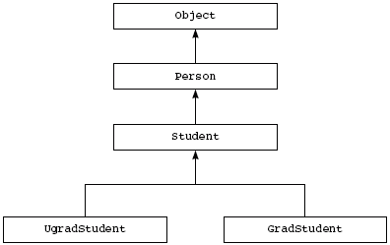
Abstract Classes
Figure 9-10
Sample class hierarchy
© 2011 Pearson Addison-Wesley. All rights reserved
9 B-<number>

Slide 15
Generic Methods
Method declarations can also be generic
  Methods can use data-type parameters
Generic methods are invoked like regular non-generic methods
Example
  public static <T extends Comparable<? super T>>
  void sort(ArrayList<T> list) {
  // implementation of sort appears here
  } // end sort
© 2011 Pearson Addison-Wesley. All rights reserved
9 B-<number>

Slide 16
Iterators
Iterator
  Object that can access a collection of objects one object at a time
  Traverses the collection of objects
JCF defines generic interface java.util.Iterator
  And a subinterface ListIterator
© 2011 Pearson Addison-Wesley. All rights reserved
9 B-<number>

Slide 17
Iterators
Defining our own Iterator class
Implement an iterator interface
  At a minimum, include methods for next( ), hasNext( ) and remove( ).
  If you don’t want to remove( ), you may leave method body empty.
MyListIterator example
  Maintain lastItemIndex to keep track of where iterator is between calls to iterator methods.
  Initialize in constructor; increment inside next( ).
© 2011 Pearson Addison-Wesley. All rights reserved
9 B-<number>

Slide 18
Summary
A subclass inherits all members of its previously defined superclass, but can access only the public and protected members
Subclasses and superclasses
  A subclass is type-compatible with its superclass
  The relationship between superclasses and subclasses is an is-a relationship
A method in a subclass overrides a method in the superclass if they have the same parameter declarations
© 2011 Pearson Addison-Wesley. All rights reserved
9 B-<number>

Slide 19
Summary
An abstract method in a class is a method that you can override in a subclass
A subclass inherits
  The interface of each method that is in its superclass
  The implementation of each nonabstract method that is in its superclass
An abstract class
  Specifies only the essential members necessary for its subclasses
  Can serve as the superclass for a family of classes
© 2011 Pearson Addison-Wesley. All rights reserved
9 B-<number>

Slide 20
Summary
Early (static) binding: compiler determines at compilation time the correct method to invoke
Late (dynamic) binding: system determines at execution time the correct method to invoke
When a method that is not declared final is invoked, the type of object is the determining factor under late binding
Generic classes enable you to parameterize the type of a class’s data
Iterators provide an alternative way to cycle through a collection of items
© 2011 Pearson Addison-Wesley. All rights reserved
9 B-<number>

